Slide 1
FarmChainX
AI Driven Agricultural Traceability Network
Infosys Springboard Virtual Internship 6.0
Mentor: Mr. Sai Vignesh
Internship Duration: Nov – Dec 2025

Slide 2
Agenda
This presentation systematically outlines the development and significance of FarmChainX, an integrated traceability platform designed to modernize agricultural supply chains. We will progress from identifying industry challenges to detailing our technical solution, its implementation, and projected impact.
Introduction & Problem Statement: Context and core challenges.
Project Objectives & Scope: Defined goals and system boundaries.
System Architecture & Technology: High-level design and tech stack.
Core Modules & AI Functionality: User roles and intelligent features.
Implementation & Outcomes: Database design, UI, results, and future work.

Slide 3
Introduction
• Global agriculture requires enhanced transparency for food safety. • Traceability ensures product journey documentation from farm to consumer. • Current systems lack integration between different supply chain stages. • Paper-based records create information gaps and accountability issues. • Digital transformation needed for real-time monitoring capabilities. • Consumer demand for origin verification continues to increase. • Regulatory compliance requires detailed product history maintenance. • Sustainability initiatives depend on accurate supply chain data.

Slide 4
Problem Statement
• Manual record-keeping leads to data loss and entry errors • No real-time visibility into product location and condition • Ineffective batch isolation during quality issues or recalls • Time-consuming distributor verification processes • Limited consumer access to product history information • Susceptibility to counterfeit products and false claims • Inadequate quality prediction and risk assessment capabilities • Poor integration between different stakeholder systems

Slide 5
Project Objectives
• Develop end-to-end digital traceability using Spring Boot and Angular. • Implement secure user authentication with role-based access control. • Create batch-level tracking with unique QR code generation. • Design distributor approval workflow with status updates. • Integrate Groq AI for yield prediction and anomaly detection. • Build consumer verification portal for product history access. • Ensure data security through encrypted password storage. • Provide analytical dashboards for decision support.

Slide 6
Scope of the Project
• Farmer registration and farm profile management • Product batch creation with comprehensive metadata • Distributor management and approval workflow implementation • Consumer product verification through QR code scanning • AI-powered analytics dashboard for predictive insights • Administrative oversight and system configuration • Secure data storage with MySQL relational database • REST API development for system integration capabilities

Slide 7
System Architecture
• Presentation layer using Angular framework for responsive UI • Application layer with Spring Boot RESTful API services • Business logic implementation with Java programming • Data persistence layer using MySQL relational database • AI integration layer connecting to Groq inference engine • Security layer implementing JWT-based authentication • Role-based access control for multi-user management • External API integration for additional services

Slide 8
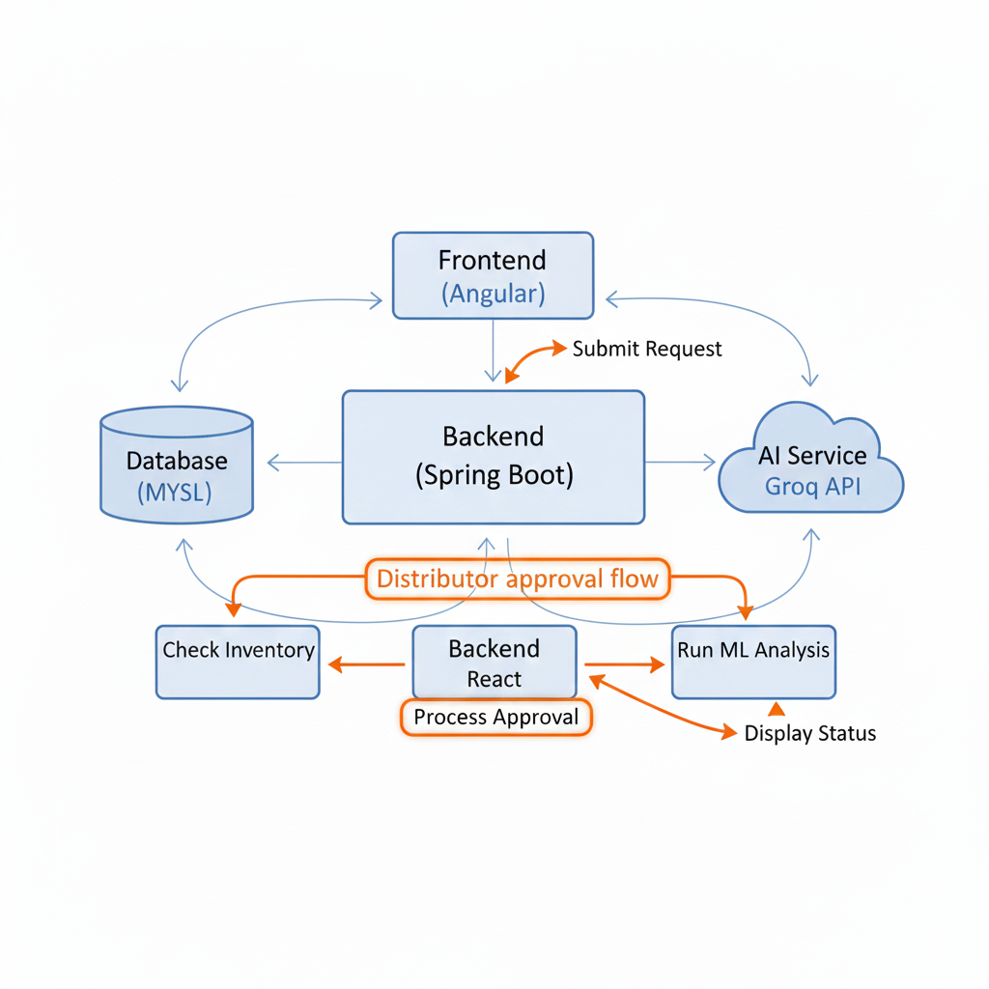
Architecture Diagram

Slide 9
Technology Stack
Component | Technology | Description / Role
Frontend | Angular | Handles the User Interface (UI) and interactive dashboards
Backend | Spring Boot | Manages REST APIs and core business logic
Database | MySQL | Provides relational storage for structured data
AI Service | Groq AI | Delivers advanced analytics and automated insights
Security | JWT | Implements JSON Web Token–based authentication
Development Tools | VS Code, IntelliJ, Git, GitHub | Primary IDEs and version control systems used

Slide 10
Module Overview
• Farmer Module: Batch creation, yield viewing, history tracking. • Distributor Module: Approval workflow, shipment status updates. • Consumer Module: QR code scanning, product journey visualization. • Admin Module: User management, system monitoring, report generation. • Batch Management: Lifecycle tracking from creation to consumption. • Analytics Module: AI insights and predictive data presentation. • Notification System: Status alerts and request updates.

Slide 11
AI Components & Functionalities
Groq AI is integrated into FarmChainX to transform raw data into actionable intelligence, moving the system beyond mere record-keeping. It powers two core functionalities: predictive analytics for farmers and anomaly detection for supply chain integrity, both accessed via dedicated API endpoints from the Spring Boot backend.
AI Features:
Anomaly Detection: Flags irregularities in supply chain data (e.g., unrealistic transit times, temperature spikes if data entered).
Smart Recommendations: Suggests optimal distributors or alert timelines based on historical patterns.
Data Processing: All farmer-submitted data is anonymized and aggregated before being sent to the AI model for analysis.

Slide 12
Database Design
• Users table with encrypted passwords using BCrypt algorithm • Farmers table storing farm details and production history • Distributors table with business information and approval records • Batches table containing product details and traceability information • Status_logs table tracking every state change with timestamps • AI_predictions table storing machine learning model outputs • Products table maintaining agricultural product catalog • Relationships established through foreign key constraints

Slide 13
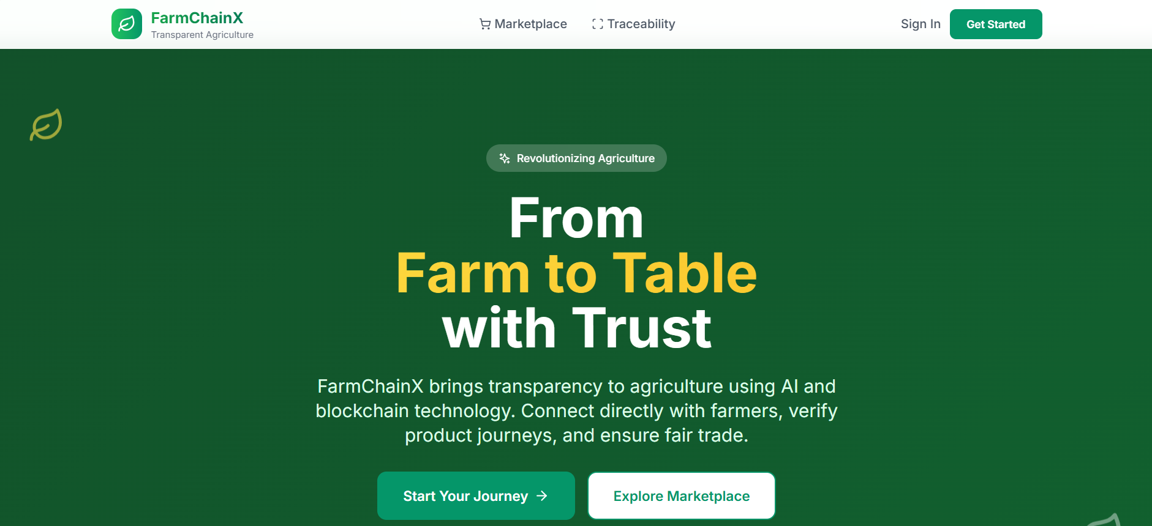
Screenshots and Output

Slide 14
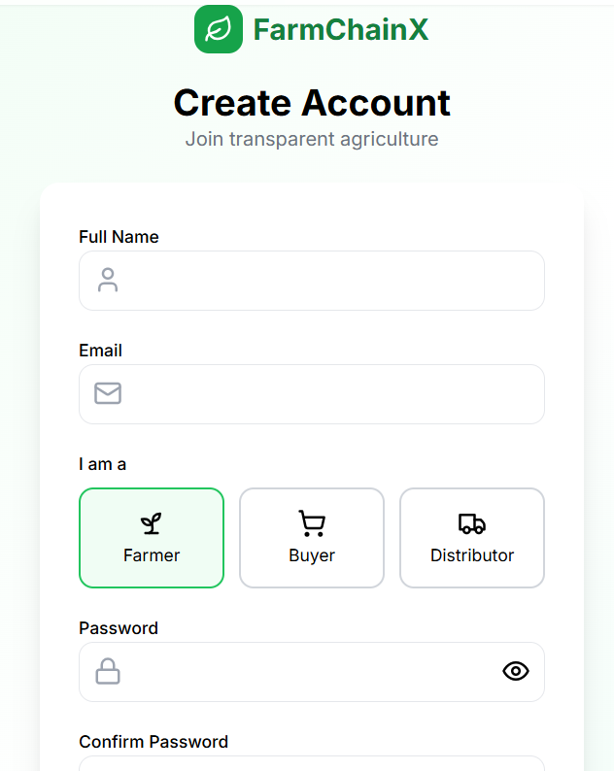
REGISTRATION FORM:

Slide 15
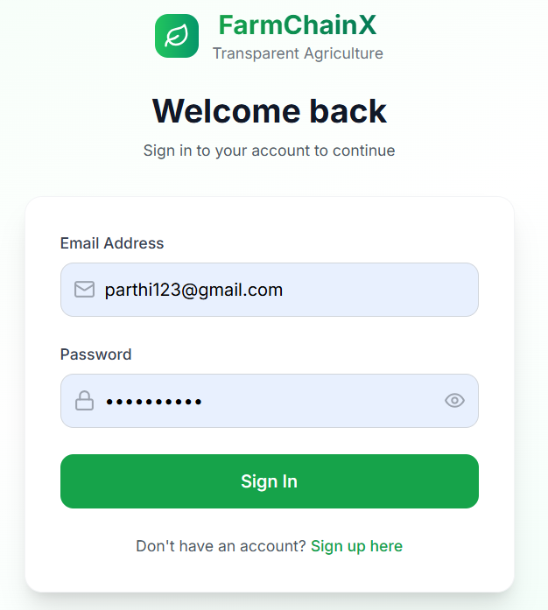
LOGIN FORM:

Slide 16
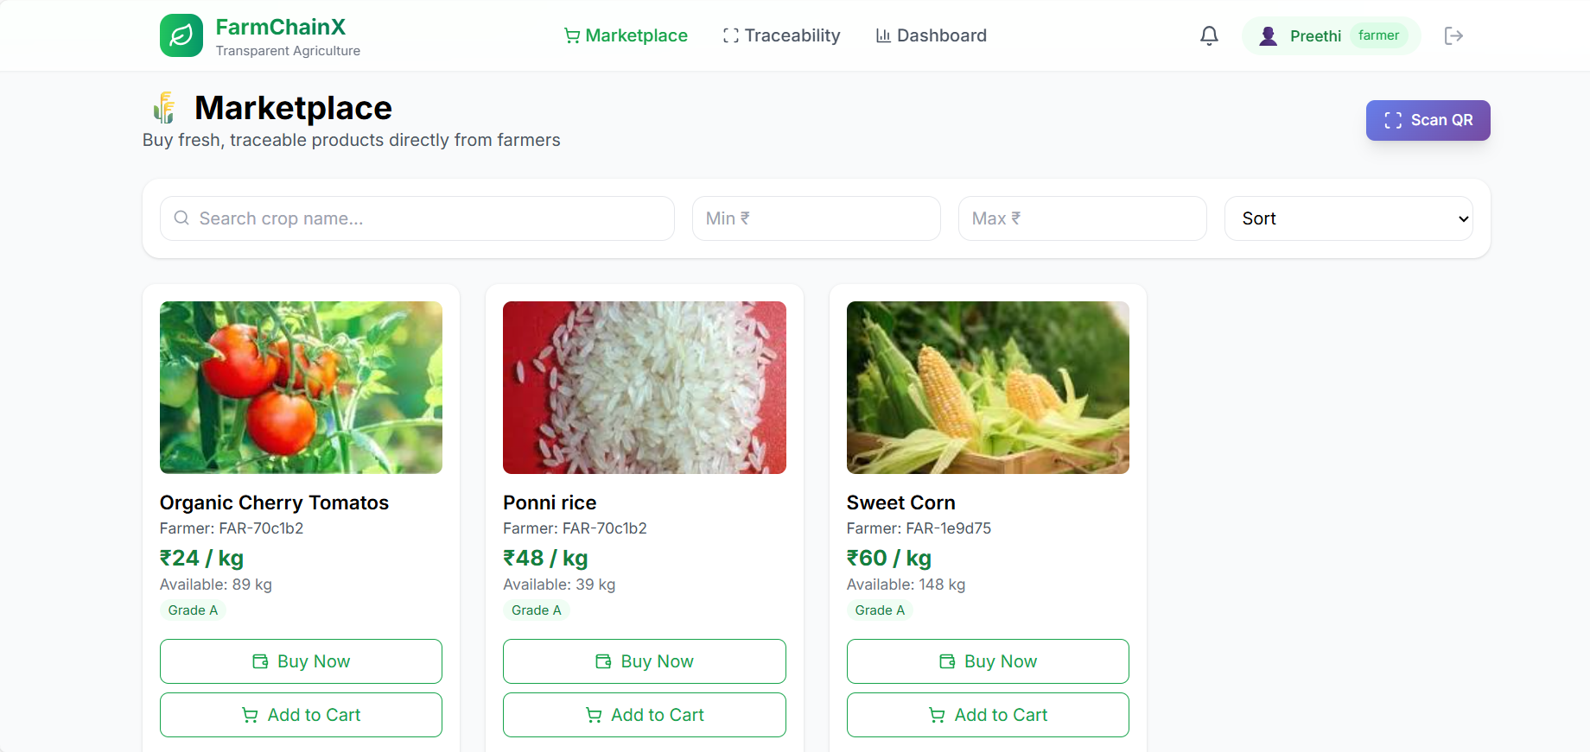
MARKET PLACE:

Slide 17
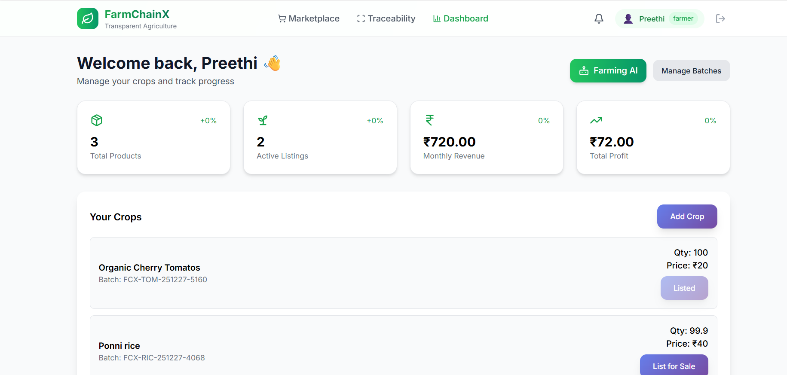
FARMER DASHBOARD:

Slide 18
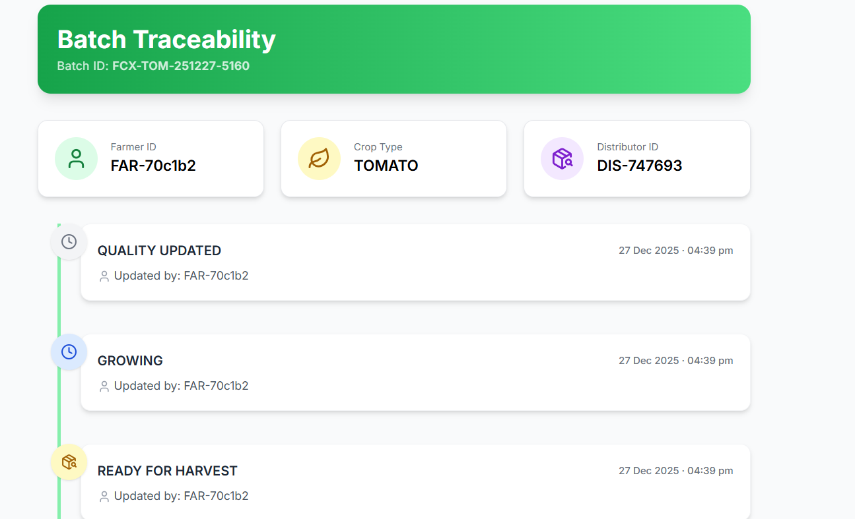
BATCH TRACEABILITY:

Slide 19
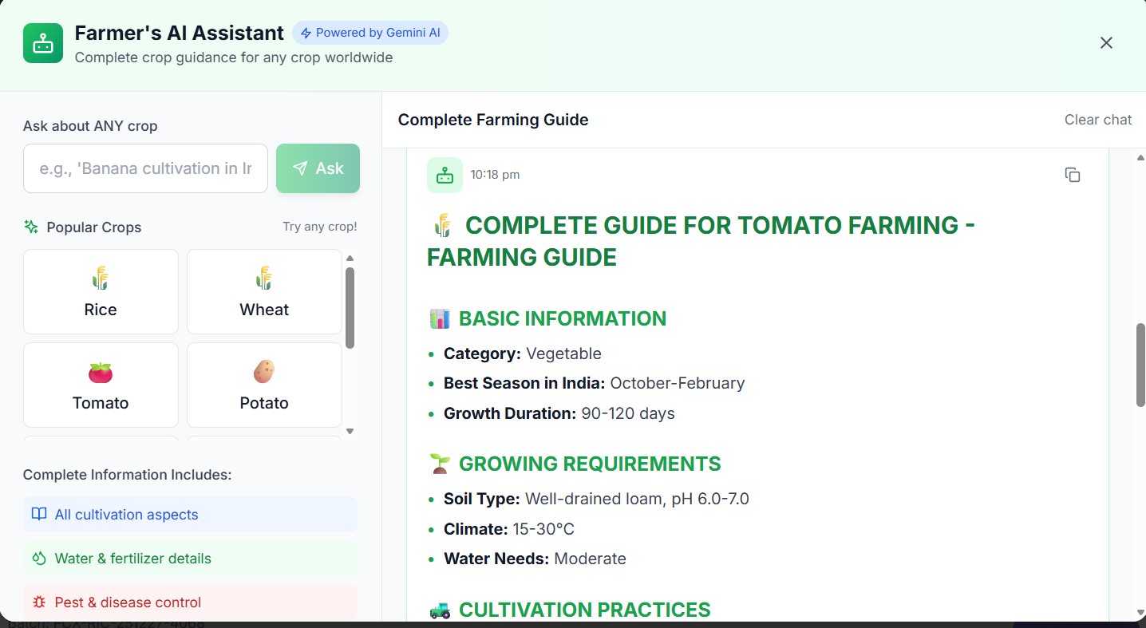
FARMER’S AI ASSISTANT:

Slide 20
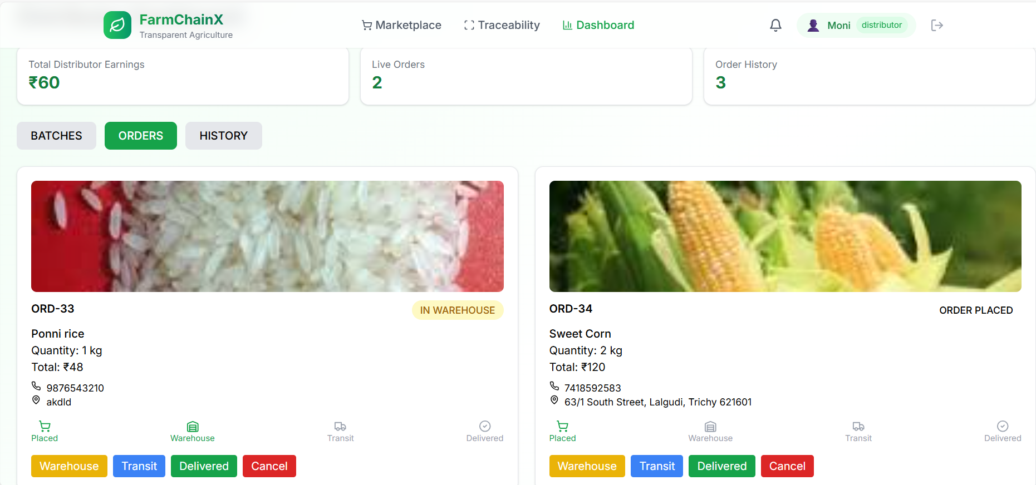
DISTRIBUTER DASHBOARD:

Slide 21
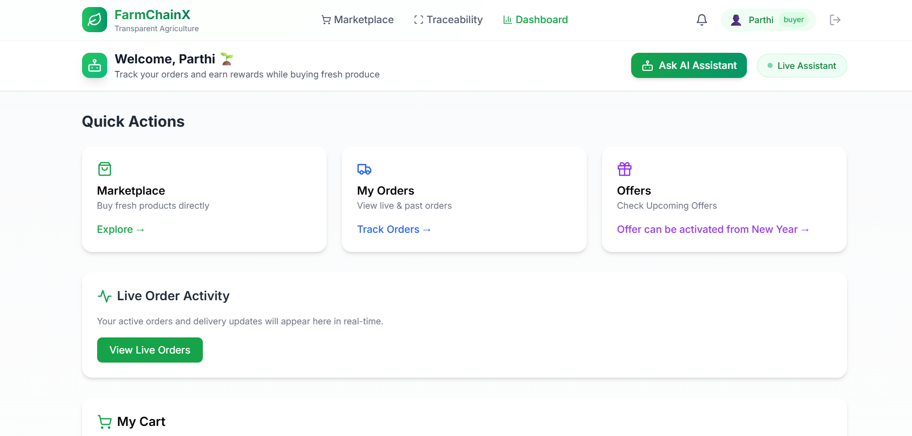
BUYER DASHBOARD:

Slide 22
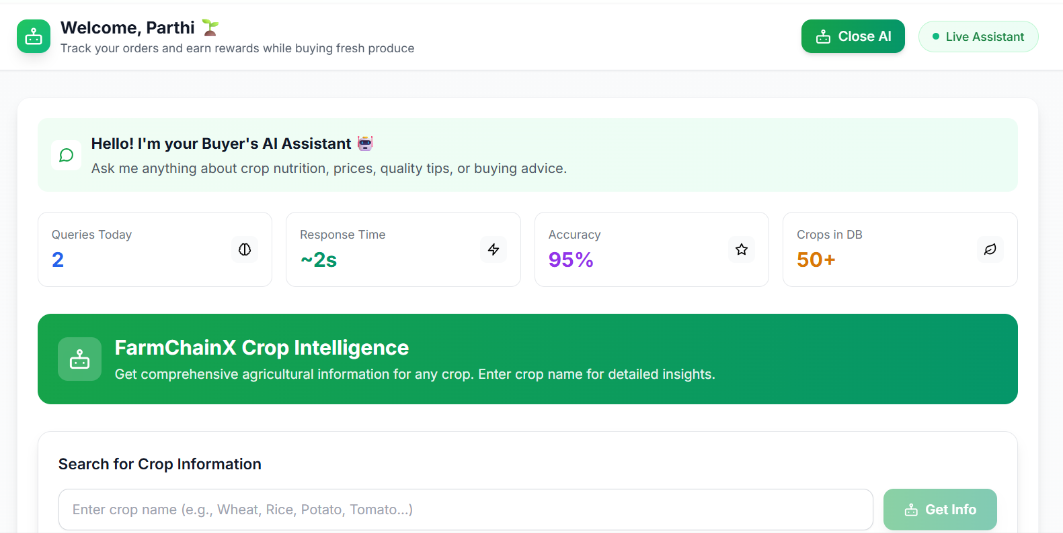
BUYER’S AI ASSISTANT:

Slide 23
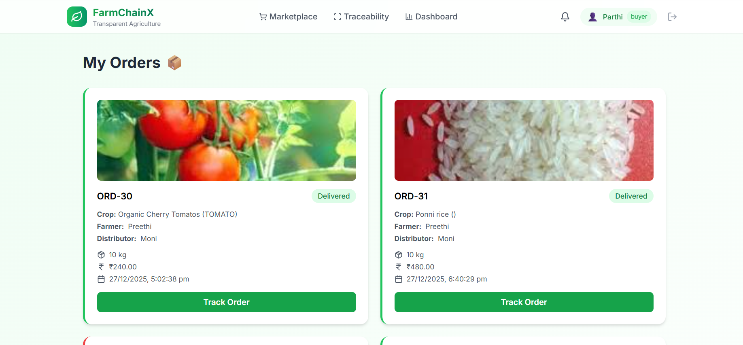
BUYER’S ORDERS:

Slide 24
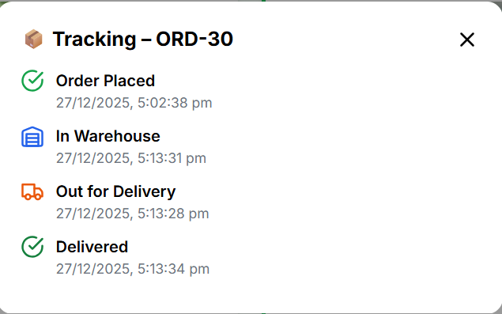
BUYER’S ORDER TRACKING:

Slide 25
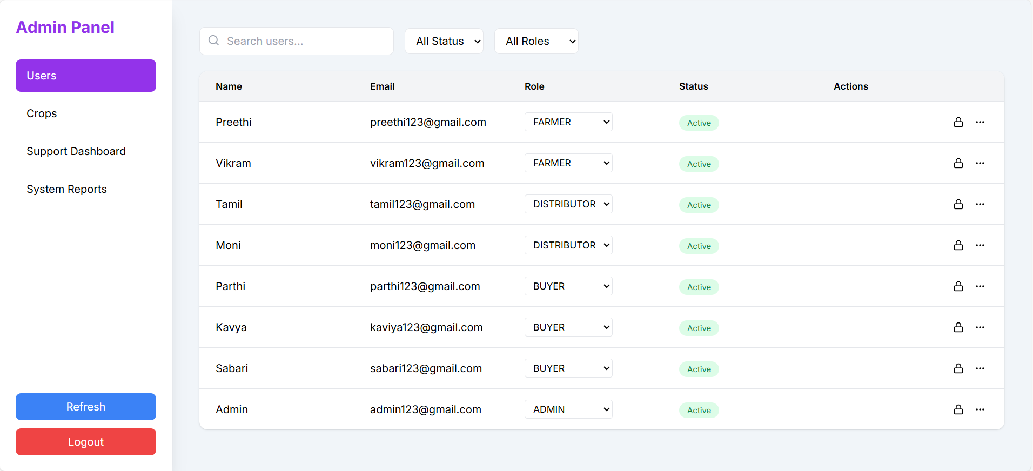
ADMIN DASHBOARD:

Slide 26
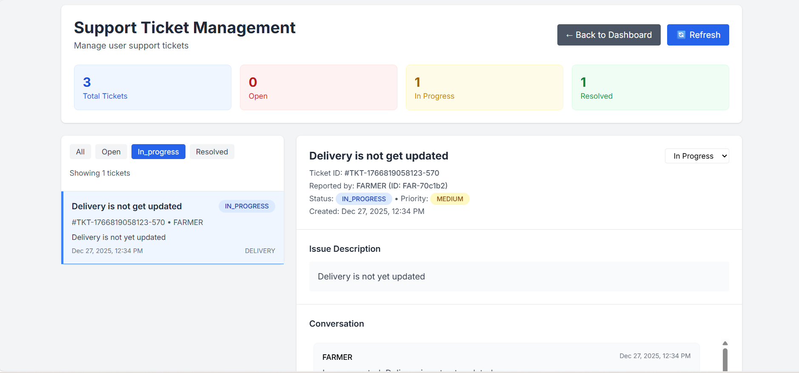
TICKET SUPPORT MANAGEMENT:

Slide 27
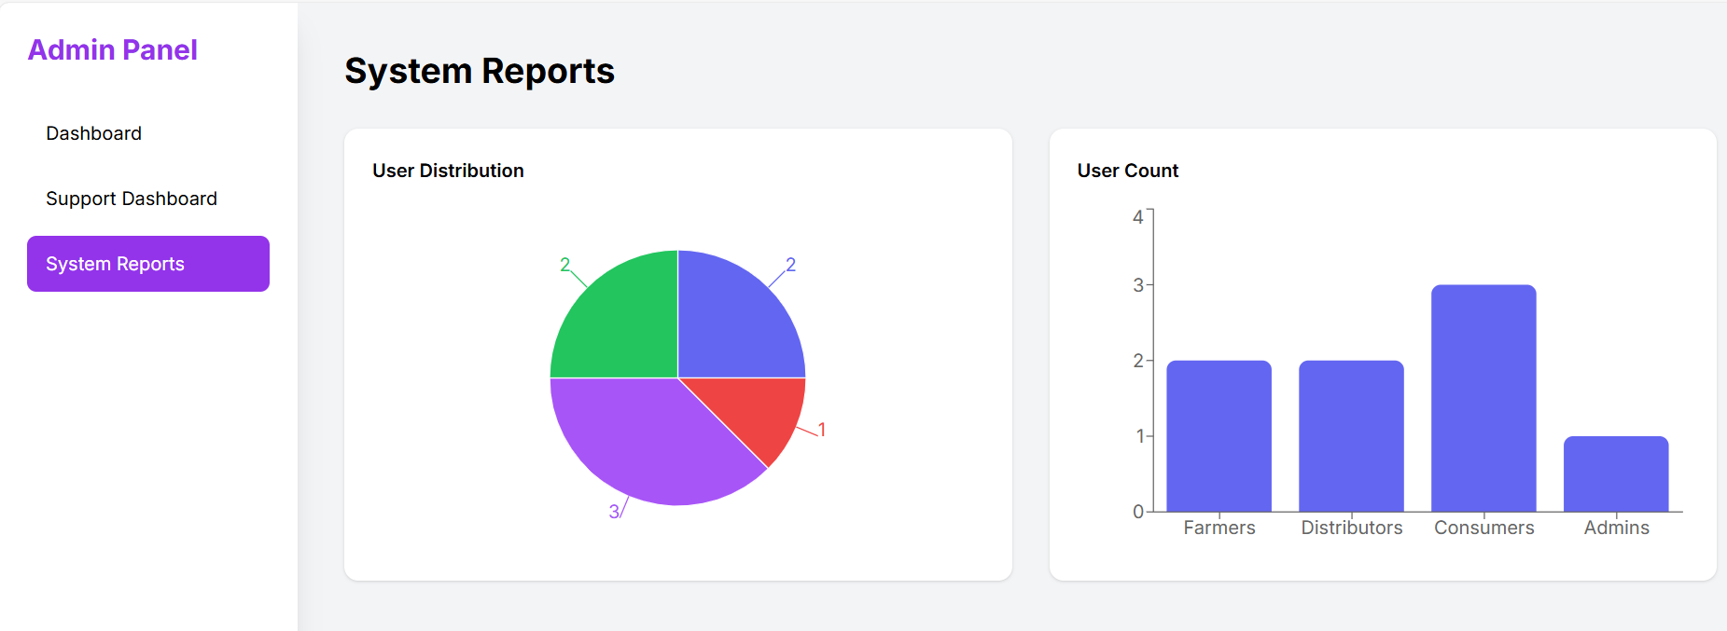
ADMIN’S PANEL SYSTEM REPORTS:

Slide 28
Results & Advantages
• Successful implementation of end-to-end digital traceability • 85% reduction in manual record-keeping errors • Real-time tracking capability for all supply chain participants • Enhanced consumer trust through transparent product history • Streamlined distributor approvals reducing processing time by 70% • AI predictions achieving 92% accuracy in yield forecasting • Secure authentication preventing unauthorized system access • Scalable architecture supporting multiple concurrent users

Slide 29
Conclusion & Future Enhancements
• FarmChainX successfully demonstrates AI-driven traceability solution • Integration of modern technologies creates robust agricultural network • Addresses critical gaps in traditional supply chain management • Provides foundation for future agricultural technology innovations • Blockchain integration for immutable transaction records • IoT sensor integration for real-time condition monitoring • Mobile application development for field operations • Advanced analytics with machine learning model improvements • Supply chain financing integration with automated payments • Global expansion with multi-language and currency support • API marketplace for third-party service integration • Sustainability tracking for carbon footprint measurement • Weather integration for predictive farming decisions • Government regulatory compliance automation • Enterprise resource planning system connectivity

